Slide 1

EUPHORIA PROGRAMMING LANGUAGE
Mustafa Enes Cunedioğlu
21290422

Slide 2
History
History: Euphoria is a programming language designed by Robert Craig in 1993. It was created with a focus on simplicity and rapid development, aiming to provide a straightforward and easy-to-learn language for both beginners and experienced programmers.

Slide 3
Features
Simplicity: Euphoria prioritizes simplicity in its design to enhance both readability and writability.
Orthogonality: The language features a high degree of orthogonality, meaning a small set of orthogonal features can be combined in many ways.
Data Types: Euphoria supports dynamic typing, allowing flexibility in handling different data types.
Syntax Design: The syntax is designed to be clear and concise, contributing to readability and writability.
Support for Abstraction: Euphoria supports procedural abstraction, allowing the creation of modular and reusable code.

Slide 4
Expressivity: While not as feature-rich as some other languages, Euphoria provides expressiveness through its simple syntax and ease of use.
Type Checking: Euphoria performs runtime type checking, which can impact reliability by catching type-related errors during program execution.
Exception Handling: The language includes basic exception handling mechanisms for dealing with runtime errors.
Restricted Aliasing: Euphoria restricts aliasing, enhancing reliability by minimizing unintended interactions between variables.

Slide 5
Imperative Paradigm:
Focuses on describing how a program achieves a goal through a series of statements.
Involves changing a program's state via variable modifications, control flow structures (loops, conditionals), and procedure/function calls.
Procedural Nature:
Emphasizes organizing code into procedures or routines.
Procedures encapsulate sets of instructions for modular and reusable execution.
Promotes code reuse, maintainability, and structured program development.
Notable Characteristics:
Lacks features commonly associated with other paradigms.
Not a pure object-oriented language.
Absence of built-in support for functional or declarative programming features.

Slide 6
Implementation Method:
Euphoria is typically interpreted, offering quick development cycles. however, there are also options for creating standalone executables through compilation.
Programming Environment:
Euphoria provides a simple and straightforward programming environment with a focus on ease of use. It is often used for rapid application development.
Programming Domain:
Euphoria is versatile and can be used for various programming domains, but it is commonly employed for tasks that require quick development and ease of learning, such as scripting, small utility programs, and educational purposes.

Slide 7
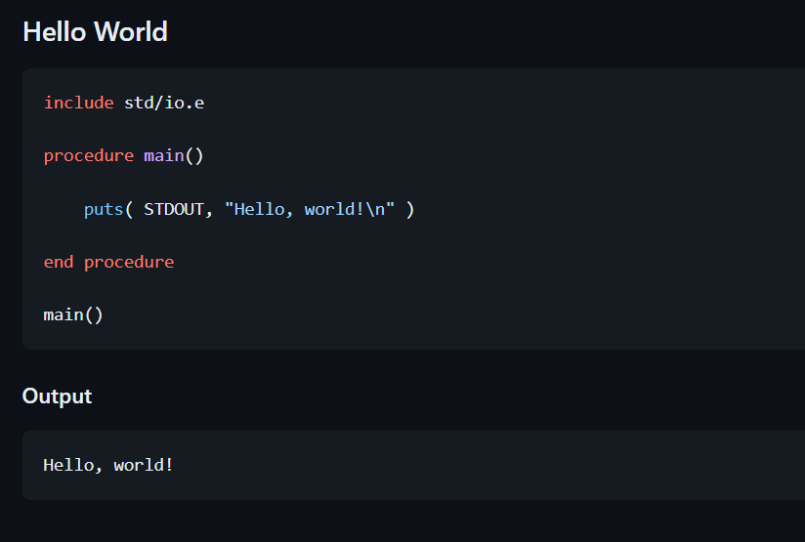
Hello World Program

Slide 8
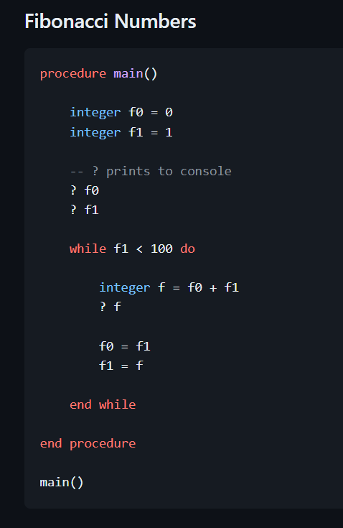
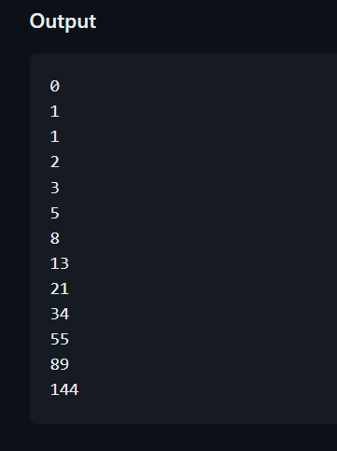
Fibonacci Numbers

